Slide 1
CER4C3 Abstractions and Paradigms of Programming
Bachelor of Engineering
Computer Engineering
II Year IV Semester

Slide 2
Standard Template Library
Components of Standard Template Library -
The standard template library consists of four components -
Containers
Iterators
Algorithms
Functors (Function Objects)

Slide 3
Standard Template Library
Containers -
Containers can be described as the objects that hold the data of the same type. Containers are used to implement different data structures for example arrays, list, trees, etc.
Iterators –
Iterators are pointer-like entities used to access the individual elements in a container. Iterators are moved sequentially from one element to another element. This process is known as iterating through a container.

Slide 4
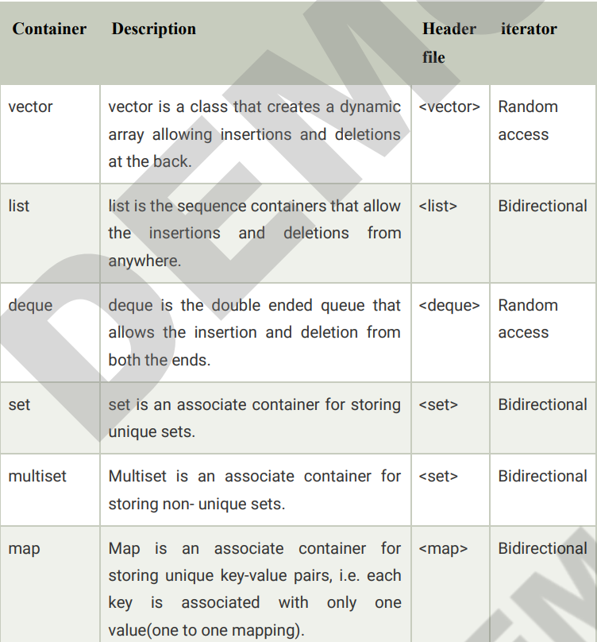
Containers in STL

Slide 5
Iterators in STL
Input iterator –
An Input iterator is an iterator that allows the program to read the values from the container.
Dereferencing the input iterator allows us to read a value from the container, but it does not alter the value.
An Input iterator is a one way iterator.
An Input iterator can be incremented, but it cannot be decremented.
Output iterator –
An output iterator is similar to the input iterator, except that it allows the program to modify a value of the container, but it does not allow to read it.
It is a one-way iterator.
It is a write only iterator.

Slide 6
Iterators in STL
Forward iterator - Forward iterator uses the ++ operator to navigate through the container. Forward iterator goes through each element of a container and one element at a time.
Bidirectional iterator - A Bidirectional iterator is similar to the forward iterator, except that it also moves in the backward direction. It is a two way iterator. It can be incremented as well as decremented.

Slide 7
Iterators in STL
Bidirectional iterator –
A Bidirectional iterator is similar to the forward iterator, except that it also moves in the backward direction.
It is a two way iterator.
It can be incremented as well as decremented.
Random Access Iterator –
Random access iterator can be used to access the random element of a container.
Random access iterator has all the features of a bidirectional iterator, and it also has one more additional feature, i.e., pointer addition.
By using the pointer addition operation, we can access the random element of a container.

Slide 8
Standard Template Library
Algorithms are the functions used across a variety of containers for processing its contents.
Points to Remember:
Algorithms provide approx 60 algorithm functions to perform the complex operations.
Standard algorithms allow us to work with two different types of the container at the same time.
Algorithms are not the member functions of a container, but they are the standalone template functions.
Algorithms save a lot of time and effort.
If we want to access the STL algorithms, we must include the header file in our program.

Slide 9
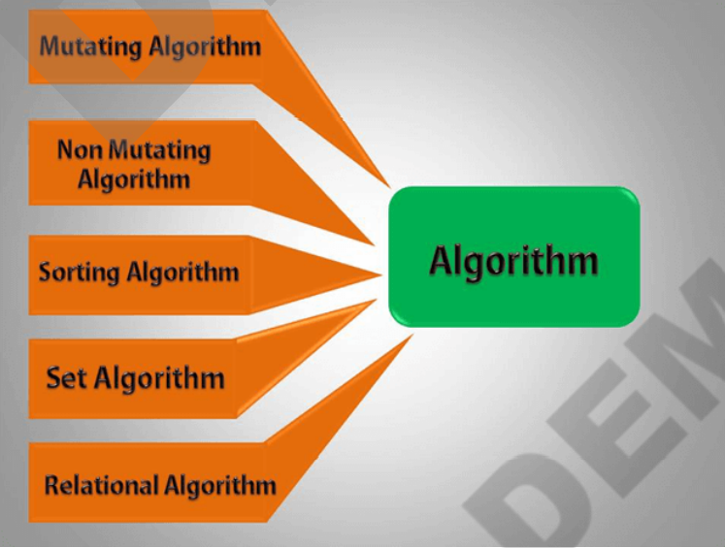
Standard Template Library

Slide 10
Standard Template Library
Nonmutating algorithms: Nonmutating algorithms are the algorithms that do not alter any value of a container object nor do they change the order of the elements in which they appear. These algorithms can be used for all the container objects, and they make use of the forward iterators.
Mutating algorithms: Mutating algorithms are the algorithms that can be used to alter the value of a container. They can also be used to change the order of the elements in which they appear.

Slide 11
Standard Template Library
Sorting algorithms - Sorting algorithms are the modifying algorithms used to sort the elements in a container.
Set algorithms - Set algorithms are also known as sorted range algorithm. This algorithm is used to perform some function on a container that greatly improves the efficiency of a program.
Relational algorithms - Relational algorithms are the algorithms used to work on the numerical data. They are mainly designed to perform the mathematical operations to all the elements in a container.

Slide 12
Standard Template Library

